Slide 2
HN Accounting
Network Support Event
Tuesday 27 February 2018

Slide 3
SQA Update
Welcome and Introduction
Domestics
Purpose of Event
Delegate Packs
Programme for the Day

Slide 4
Network Support Event - Programme
SQA Update
Supporting Staff – A Centre Case Study
Coffee/Tea
Accounting: Graded Unit 2 Workshops
Lunch
Senior External Verifier – Review of 2016/17
NC Accounting and Foundation Apprenticeship Update
Making Assessment Decisions
Plenary and Close

Slide 5
HN Accounting - Uptake
HNC Accounting – 7th (6th)
HND Accounting – 3th (4th)
PDA Bookkeeping – 6^{th (7th)}
PDA Financial Accounting – 5th ^{(8th)}
PDA Management Accounting –7th (9th)
(2014/15 figures given in brackets)
https://www.sqa.org.uk/sqa/80674.html

Slide 6
*Figures up to and including 31 December 2017 |  |  |  | 2014/15 |  | 2015/16 |  | 2016/17 |  | 2017/18
Type | Code | Level | Title | Entries | Awards | Entries | Awards | Entries | Awards | Entries | Awards
HN-P | G9M5 | 15 | Accounting | 831 | 654 | 834 | 647 | 948 | 668 | 565 | 72
HN-P | G9M6 | 16 | Accounting | 926 | 599 | 882 | 530 | 771 | 556 | 531 | 53
PDA-N | G8XK | 47 | Management Accounting | 143 | 130 | 281 | 239 | 327 | 270 | 285 | 3
PDA-N | G8XM | 47 | Financial Accounting | 156 | 129 | 292 | 230 | 327 | 248 | 290 | 18
PDA-N | G8XN | 47 | Book-keeping | 189 | 162 | 288 | 220 | 358 | 236 | 370 | 49

Slide 7
HN Accounting – 2017/18
Prompt Payment Discount introduced into Recording Financial Information
H7V4 34 Preparing to Start a Business added as an optional Unit to both HNC and HND frameworks in December 2017
Information on ‘Updating Units with Tax Content’ added to web page
Few Comment Forms received about ASPs

Slide 8
HN Accounting
Monitor impact on units such as Payroll and Income Tax to take account of any changes which may be required as a result of devolving fiscal powers to the Scottish Government.
  Proposed Scottish rates and bands for 2018/19
  On the 31 January the Scottish Government announced the following proposals for income tax rates and bands.
  * Assumes person is in receipt of the Standard UK Personal Allowance
  ** Personal Allowance is reduced by £1 for every £2 earned over £100,000
Proposal for Ethics unit to be written and included in options for both HNC and HND
Bands | Band name | Rates (%)
Over £11,850*-£13,850 | Starter Rate | 19
Over £13,850-£24,000 | Basic Rate | 20
Over £24,000-£43,430 | Intermediate Rate | 21
Over £43,430-£150,000** | Higher Rate | 41
Above £150,000** | Top Rate | 46

Slide 9
HN Accounting
QST Meetings
Centre/Candidate Surveys
Information regarding HN Accounting placed on Subject web page – update letters, event presentations, etc
Understanding Standards (login required for HN) - http://www.understandingstandards.org.uk/Home

Slide 10
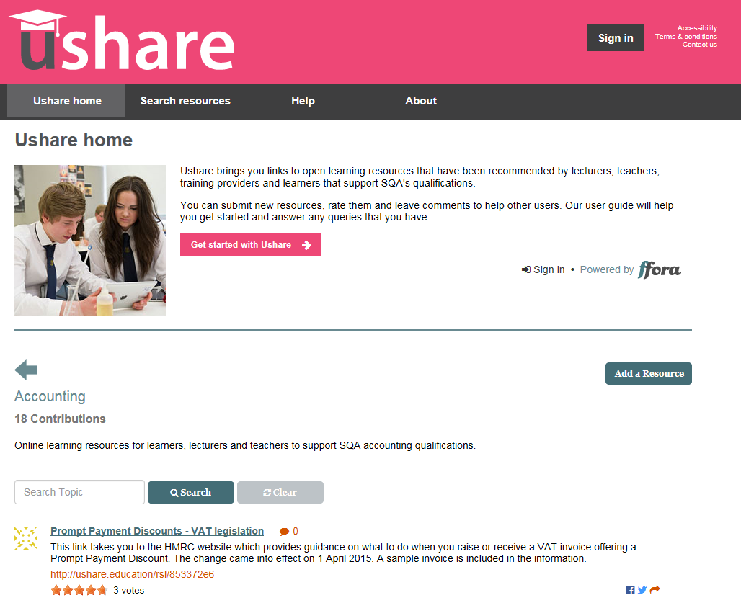
HN Accounting

Slide 11
HN Accounting – Subject-related Qualifications
NPA in Financial Services at SCQF level 6 - part of Foundation Apprenticeship in Financial Services – delivered via school/college partnerships
Revised SVQs in Providing Financial Services
Work on NC Accounting Units currently being carried out – contribute to NC Accounting and new NPA. The NPA will form part of the Foundation Apprenticeship in Accounting

Slide 12
HN Accounting - Miscellaneous
From 2017 onwards Internal Assessment Reports have been renamed Qualification Verification Summary Report
Informing Flexibility in HN
SQA toolkit will be updated with revised guidance -http://www.sqa.org.uk/sqa/64144.html

Slide 13
Keeping informed
For more information, visit www.sqa.org.uk/hn
To receive email alerts, when content you are interested in has been added to or updated on SQA’s website, subscribe to MyAlerts at www.sqa.org.uk/myalerts
Look out for Centre News – SQA’s weekly update for centres.
To subscribe, go to http://mailer.sqa.org.uk/Centrenews/Step1

Slide 14



Follow us online
YouTube – SQAonline
Facebook – Scottish Qualifications Authority
Twitter - @sqanews

